Slide 1
Secondary growth
And
Anomalous secondary growth
In boerhaaviA (dicot)
Dracaena (monocot)

Slide 2
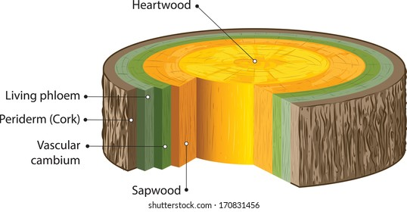
Secondary growth
Secondary growth is the growth that results from cell division in the cambia or lateral meristems and that causes the stems and roots thickning.
It occur in evergreen species then in decidious one.
Cambium
A cambium, in plants, is a tissue layer that provides partially undifferentiated cells for plant growth.
It is a thin formative layer between the xylem and phloem of most vascular plants that gives rise to new cells and is responsible for secondary growth

Slide 3
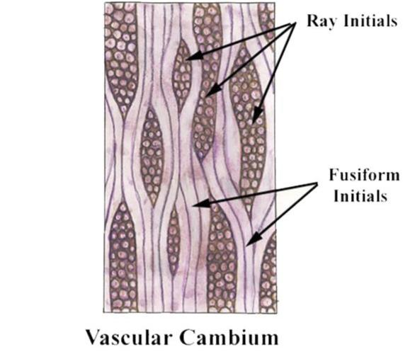
Structure of cambium
Ray initials
IsodiamEtric with flattened axis
Give rise to parenchymatous vascular rays
Formed from the radials system of cambium.
Fusiform initial
Elongated with tapering ends.
Spindle in shape
Occur in middle region and give rise to secondary xylem and phloem.

Slide 4
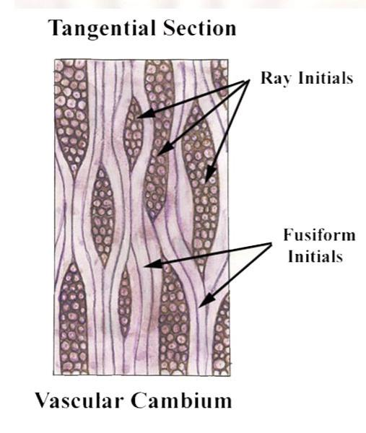

Slide 5
Seasonal activity of cambium
Cambium of some plants remains active for the entire period of their life, i.e., cambial cells divide and resulting cells mature to form xylem and phloem elements.
This type of seasonal activity usually found in the plants present in the tropical regions, and not all plants show cambial activity.
Percentage of ringless trees in the rain forests of;
India : 75%
Amazon : 43%
Malaysia : 15%

Slide 6
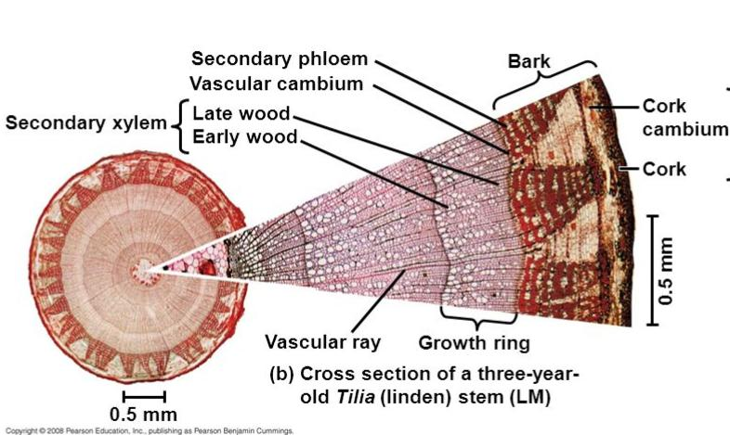
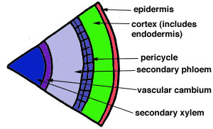
In regions with definite seasonal climate; seasonal activity of cambium ceased with onset of unfavorable conditions;
In Autumn, it enters the dormant state and lasts for the end of summer
In Spring, cambium again becomes active.
Duration of cambial activity is also affected by day- length
e.g., In Robinia pseudoacacia, cambium is dormant under short-day condition.

Slide 7
Secondary growth in stem
The cambium cells formed in circular in cross section from the beginning onwards.
The cambial ring is partially primary (fascicular cambium) and partially secondary (interfascicular cambium).
Periderm originates from the cortical cells (extra stelar in origin).
In Dicot stem, for mechanical support xylem is with comparatively smaller vessels, greater fibers and less parenchyma.
More amount of cork is produces for protection

Slide 8
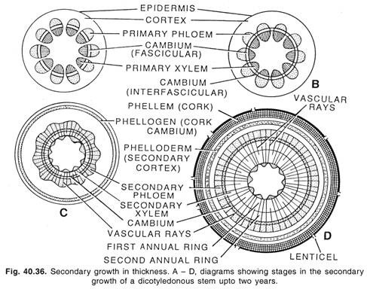

Slide 9
Secondary growth in roots
The cambial ring formed is wavy in the beginning and later becomes circular.
The cambium ring is completely secondary in origin.
Periderm originates from the pericycle (intra stelar in origin).
In Dicot root, xylem is with big thin walled vessels with few fibers and more parenchyma.
Less amount of cork is produced as root is underground

Slide 10
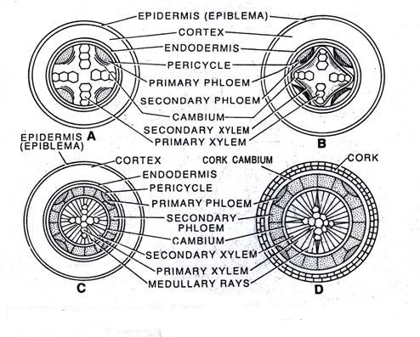

Slide 11
Wood
The term wood is used for sec. Xylem produced due to activity of cambium in the stems of gymnosperm and dicotyledon angiosperm
Soft wood
Wood lacks vesssels.
Also called non porous
Found in gymnosperm.
Trachieds quantity 90-95%
Hard wood
CoNtain vessels
Also called porous wood.
Trachieds are only upto 5%in quantity.
Wood fibres are abundant.

Slide 12
Anomalous secondary growth
Anomalous secondary growth is the abnormal secondary growth which does not give rise to the normal pattern of single vascular cambium which forms xylem and phloem rather they posses multiple cambium giving rise to abnormal secondary structures

Slide 13
Anomalous Secondary Thickening in Dracaena stem (Monocot)
• The secondary growth happens by abnormal growth from abnormal
cambium in monocot. In monocotyledons normally the vascular
bundles are closed. The cambium being absent the secondary growth
is absent; but in some plants like Dracaena and Yucca secondary
growth takes place.
• The normal cambium either does not develop. This abnormal cambium
may either develop from cortex or pericycle and shows abnormal
activity.
• The young stem has typical structure i.e. epidermis is followed by
sclerenchymatous hypodermis. A large number of closely arranged
bundles are scattered in ground tissue.

Slide 14
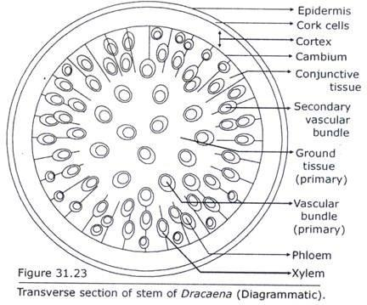
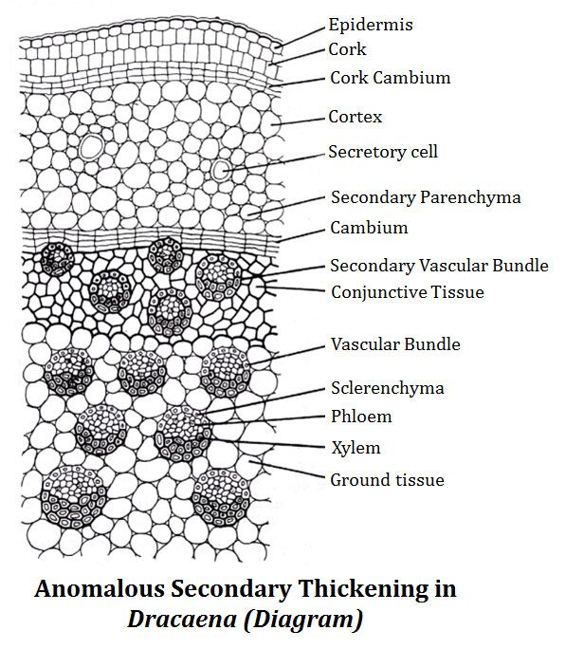

Slide 15
One of the outer layers of cells from the ground tissue becomes meristematic and functions as cambium.
The cambium formed in the region which has
ceased elongating.
• The activity of this cambium is more on the inner side and very little on the outside where
it forms only parenchyma.
On the inner side it forms xylem and parenchyma in alternate patches. The inner
parenchymatous cells are called conjunctive tissue.
• After a short while the activity of cambium on inner side changes and above the xylem it
starts forming phloem and then again xylem. The xylem formed earlier has bigger vessels.
• Around each vascular bundle is developed sclerenchymatous sheath

Slide 16
The cambium after sometime alters its activity and forms xylem on the
inner side, at those places where it was previously forming the
parenchyma and parenchyma in place of xylem. Similar to earlier case
again by change in activity it forms a ring of vascular bundles.
• Activity of cambium goes on changing regularly and more rings of
vascular bundles are formed.
• Cork cambium is formed below hypodermis and forms cork and cork
cambium in normal fashion.

Slide 17
Anomalous Secondary Thickening in Dicot stem (Boerhaavia – Stem)
The anamolous secondary growth of dicot (Boerhaavia) stem showed
following tissues from outside within:
Epidermis:
• Single layered epidermis consists of small, radially elongated cells.
• Multicellular epidermal hairs arise from some cells.
• A thick cuticle is present on the epidermis.
• Some stomata are also present.
Cortex:
• It is well differentiated and consists of few layered collenchymatous
hypodermis followed by chlorenchyma.
• Collenchyma is 3 to 4 cells deep, but generally near stomata

Slide 18
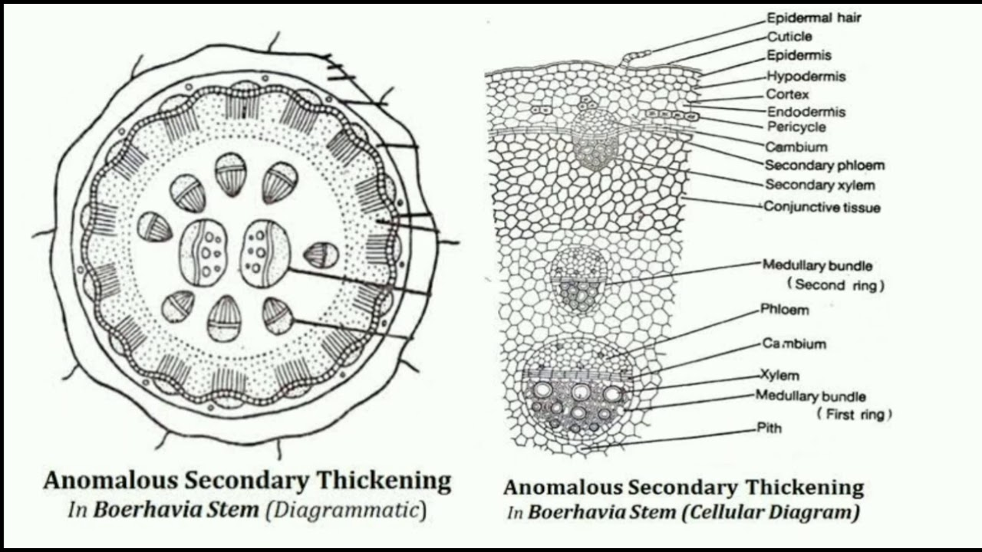

Slide 19
it is only one layered.
• Chlorenchyma is present inner to collenchyma in the form of 3 to 7
layers.
• Chlorenchymatous cells are thin walled, oval, full of chloroplasts and
enclose many intercellular spaces.
• Endodermis is clearly developed and made up of many, tubular, thick-
walled cells.
Pericycle:
• Inner to the endodermis is present parenchymatous pericycle but at
some places it is represented by isolated patches of sclerenchyma.

Slide 20
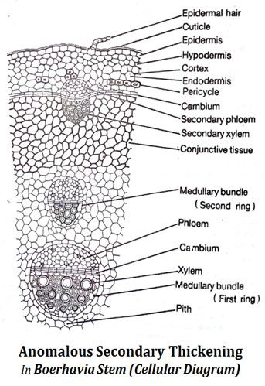
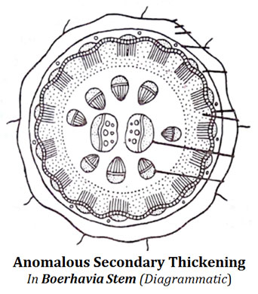

Slide 21
Vascular System:
• Vascular bundles are present in three rings. In the innermost ring are
present two large bundles; in the middle ring the number ranges from
6 to 14 while the outermost ring consists of 15 to 20 vascular bundles.
• Vascular bundles of innermost and middle rings are medullary bundles.
• Vascular bundles are conjoint, collateral and endarch.
• Two vascular bundles of the
innermost ring arc large, oval and
lie opposite to each other with
their xylem facing towards centre
and phloem outwards.
• Middle ring consists of 6-14 small
vascular bundles.

Slide 22
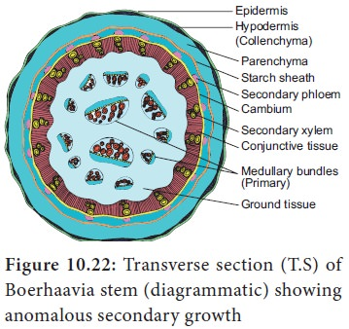
Vascular bundles of inner and
middle rings may show a little
secondary growth.
• Phloem consists of sieve tubes,
companion cells and phloem
parenchyma while the xylem
consists of vessels, tracheids and
xylem parenchyma.
• Outermost ring of the vascular
bundles contains inter-fascicular
cambium which is absent in other
two rings.

Slide 23
Cambium develops secondarily from the pericycle and becomes active.
It cuts secondary phloem towards outer side and secondary xylem
towards inner side. Due to these changes the primary phloem becomes
crushed and present next to pericycle. Primary xylem is situated near
the pith.
• Interfascicular cambium also soon becomes active and cuts internally
the row of cells which become thick walled and lignified and are known
as conjunctive tissue.
Pith:
• It is well developed, parenchymatous and present in the centre.

Slide 24


